Slide 1




Air Force ROTC Detachment 730
at the University of Pittsburgh
& 15 Cross-town Schools
Phone: (412) 624-6031
Email: afdet730@pitt.edu
Visit: Cathedral of Learning 29th Floor

Slide 2

AFROTC Det 730
An Exciting Job After College
Have an accelerated profession
with great benefits!
Be part of good work worth doing!
Numerous Career Paths
Flying Specialties | Cyber
Intelligence | Space Operations
Special Warfare | Weather
Maintenance | Logistics
Civil Engineer | Force Support
Public Affairs | Security Forces
Medical | Chaplain
Scientist | Engineer
Acquisition/Contracting | Special Investigations
and many more!

Slide 3
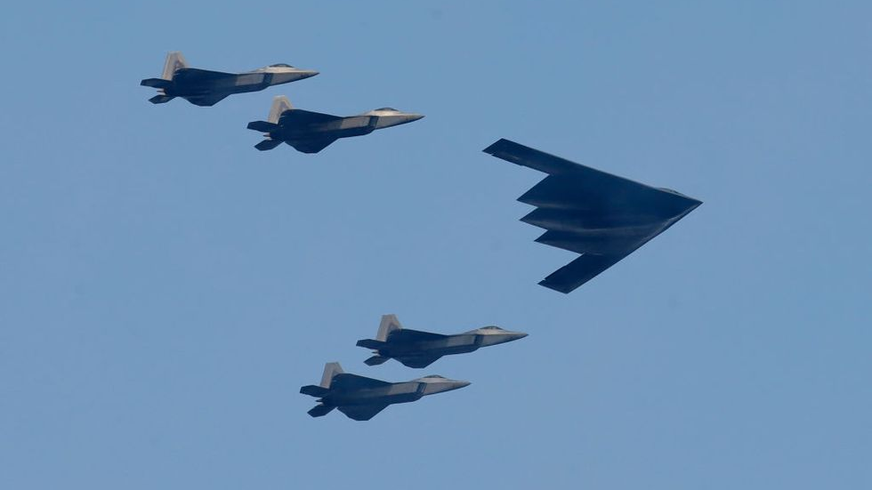
Shape the Future of Air Combat.
DAF has the best Aircrew in the world.
Want to Fly?
- Pilot
- Remotely Piloted Aircraft Pilot
- Combat Systems Officer
- Air Battle Manager
AFROTC helps prepare you:
Flying Hours (Maxes at 60 hours)
TBAS Exam
AFOQT (Specific Sections)
Physical Fitness Assessment
PCSM Score
Competitive Flying Careers Selection

Slide 4
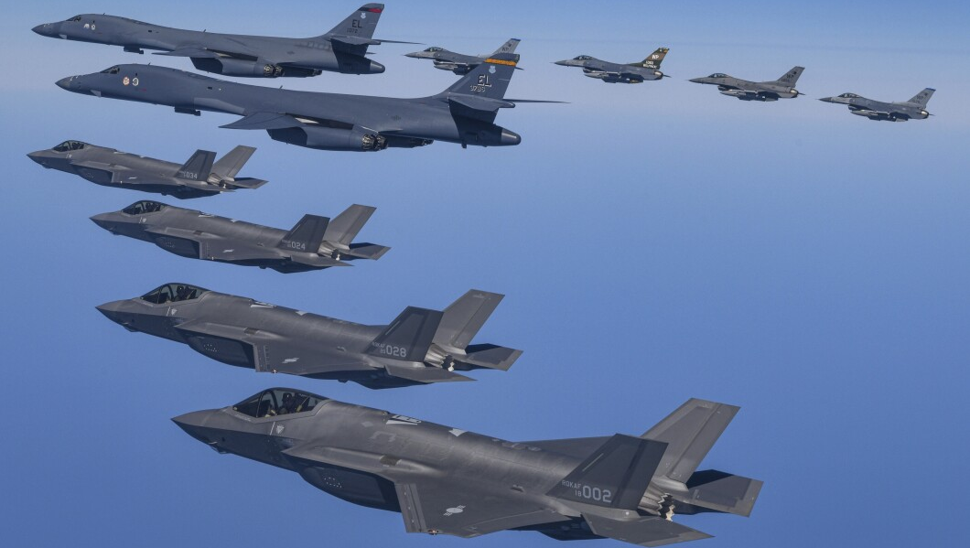
Joining AFROTC & Scholarships:
  5% High School Scholarship Cadets
  - Type 1 - Full Tuition & Fees
  - Apply: 1 Jul - 31 Dec during H.S. Senior Year
  - Very Competitive Full Person Assessment
  95% Walk on Cadets
  - Last 2 Years: Type 2 - Around $9K/Semester
All Scholarship Cadets
- Cadet Pay (up to Senior Year $500/mo)
- Book Stipend of up to $900/yr
- Optional Conversion to $10K/yr Housing

Slide 5
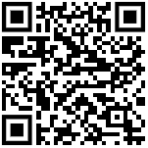

Joining AFROTC & Enrollment:
  10% High School Scholarship Cadets
  Nation-wide Online Application
  https://www.afrotc.com/scholarships/high-school/application/
  90% Walk on Cadets
  AFROTC DET 730:
  As simple as emailing us then:
  - Academic Enrollment
  - New Cadet Orientation
  - 23 Aug 2025

Slide 6
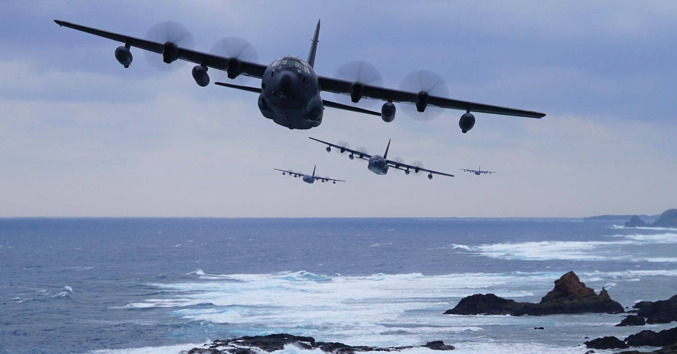
Across the United States:
145 AFROTC Detachments serve
1,100+ Universities
AFROTC Det 730 Proudly Serves:
University of Pittsburgh, Pitt - Greensburg,
Carlow University, Carnegie Mellon University,
Chatham College, Community College of Allegheny County,
Duquesne University, Franciscan University of Steubenville, La Roche University, Penn State - Greater Allegheny,
Penn State - New Kensington, Penn West (California),
Point Park University, Robert Morris University,
Saint Vincent College, and Washington & Jefferson College

Slide 7
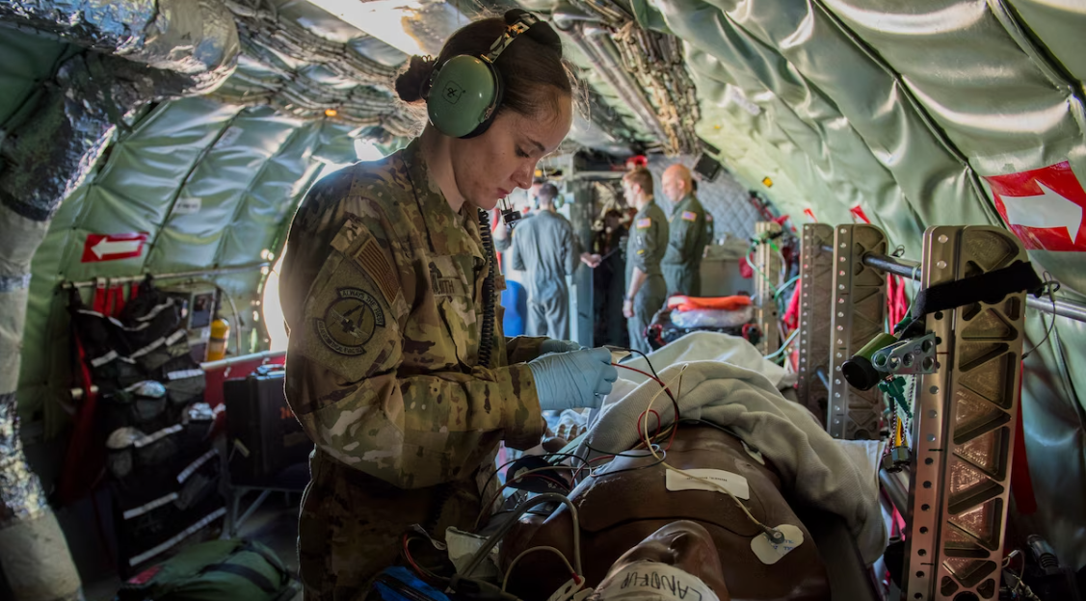
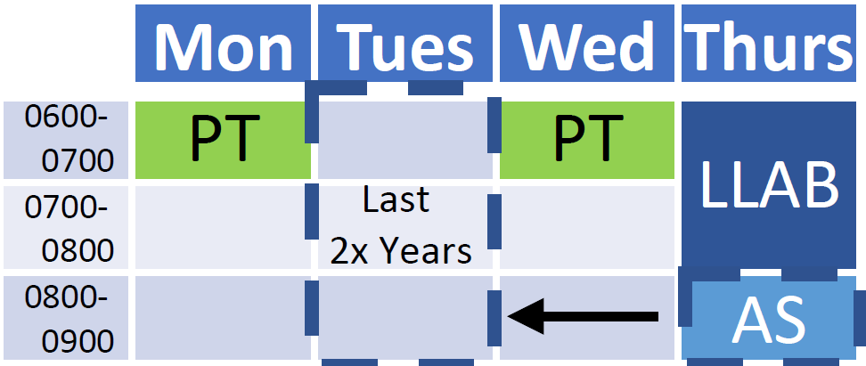
AFROTC Detachments’
Schedules have the same elements;
however, times may vary.
AFROTC Detachment 730
Weekly Schedule:
2 PTs, Lab Class, & Academic Class
- In vs Out of City Limits Consideration

Slide 8
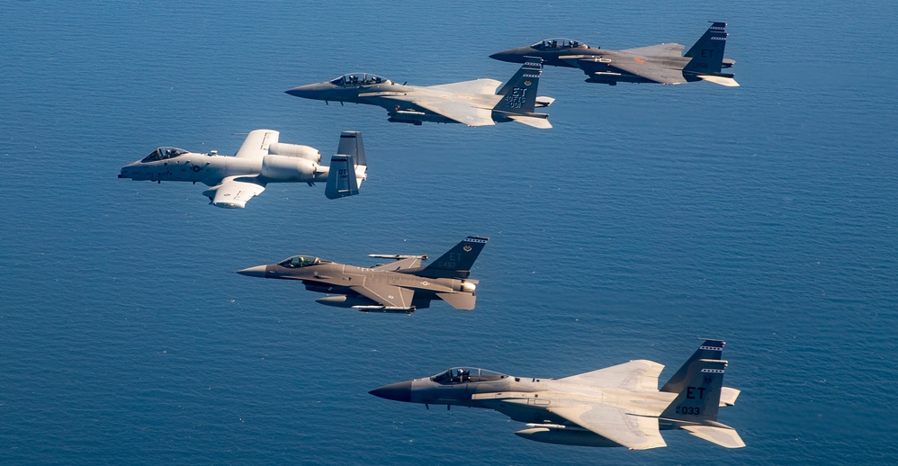

Year to Year Development
AS100 Introduction to the Air Force:
Heritage & Values
AS200 Dynamic Teams Operations:
Teamwork & Leadership
AS300 Officer Professionalism
& Unit Leadership
AS400 Organization Leadership &
National Defense Strategy
Entering Active Duty as a 2nd Lt
Program Milestones
AS100
AS200
AS300
AS400
Medical Exam Exam
AFOQT Exam
AFOQT Exam
Pass Physical Fitness Assessment
Field Training Selection Board
Intentional Build Up Approach:
“Developing Leaders of Character”
Summer Field Training
Finalized Air Force Profession
Finalized First Assignment Base
Commissioning as 2nd Lts
Entering Active Duty as a 2nd Lt

Slide 9
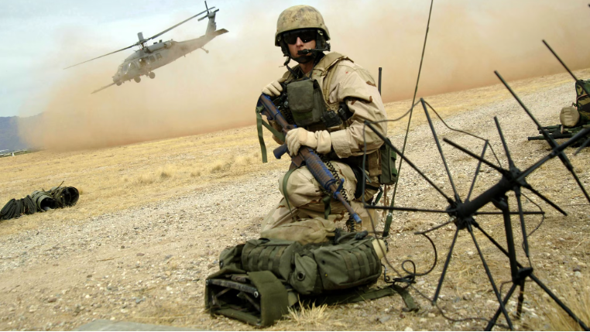
Awesome Opportunities
Competitive experiences available both locally and nationally:
Language Training/Travel | Glider Flying
Civil Aviation Flight Funds | Jump School
Career-field Immersion | Combative Martial Arts
Cyber Camps | Engineering Camps
Survival Training | Exclusive Internships
and many more!

Slide 10
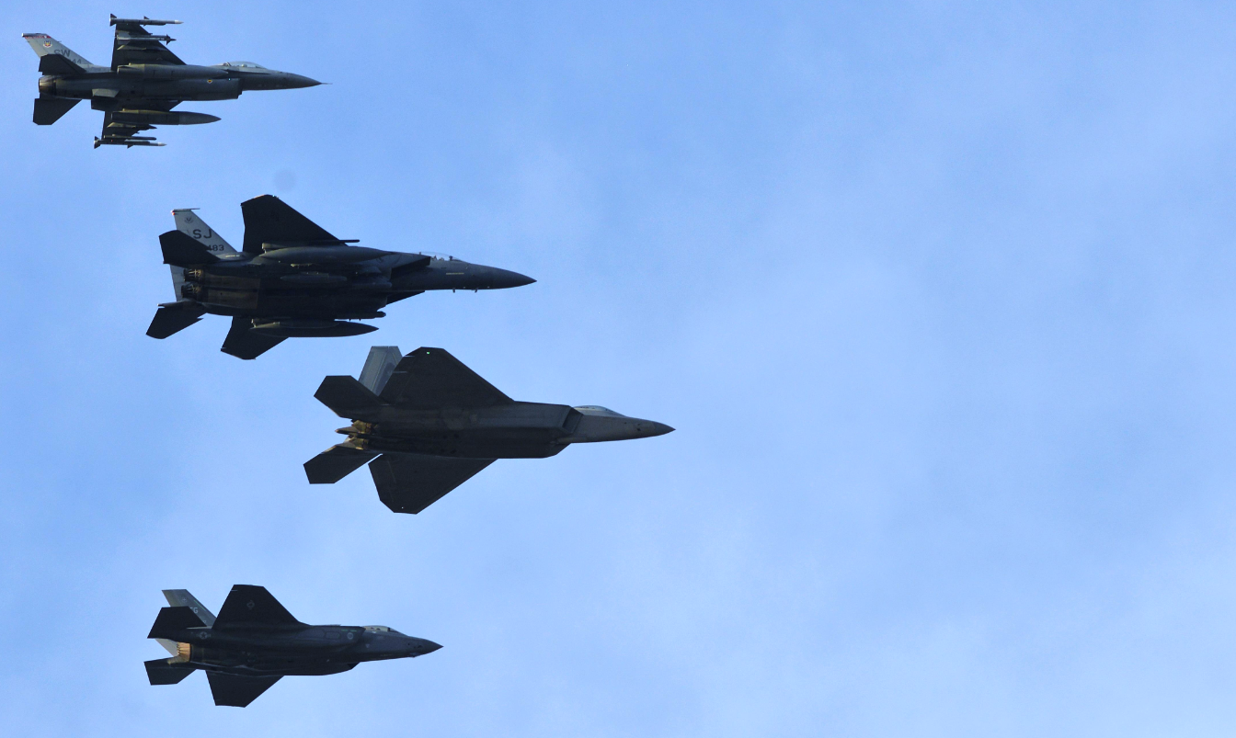
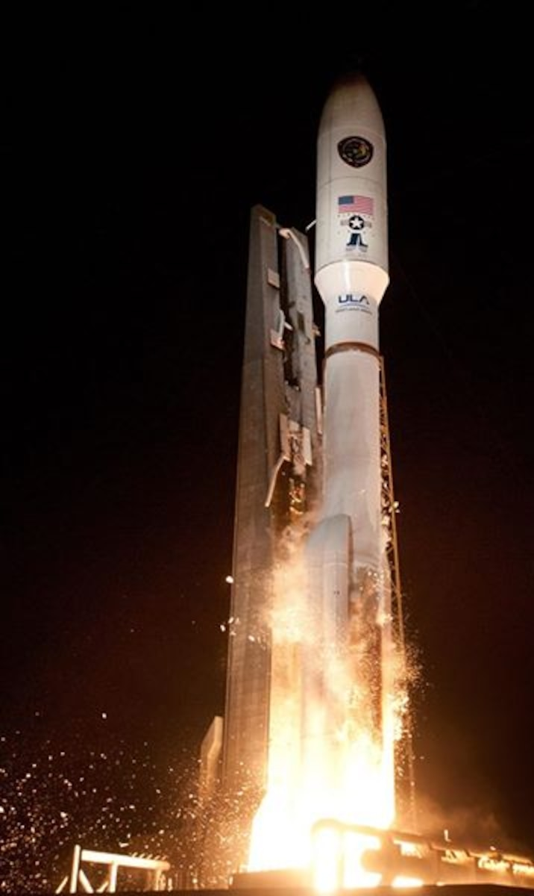
Aim High!
Integrity – Service - Excellence

Slide 11
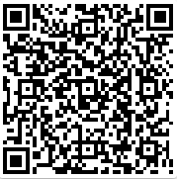
Phone: (412) 624-6031
Email: afdet730@pitt.edu
Visit: Cathedral of Learning 29th Floor
Interest Form
Fill out & We will contact
Prior to Next Semester Start
Email Us for info, enrollment procedures, or a Facility Tour
USAF PT Standards
Exercises: (a) Pushups,
(b) Situps, (c) 1.5 mi run

